Slide 1
Introduction to LangGraph

Slide 2
Introduction to LangGraph
Graph-Based Orchestration for LLM Applications
Stateful Workflows
Production-Grade Agent Systems
FDE Perspective

Slide 3
Agenda
Why LangGraph?
Core Concepts
Architecture Deep Dive
Design Patterns
Production Readiness
FDE Benefits

Slide 4
Evolution of LLM Applications
Prompt → Response Systems
Linear Chains
Autonomous Agents
Graph-Based Stateful Systems

Slide 5
Production Challenges in LLM Systems
Uncontrolled agent loops
Lack of deterministic workflows
Difficult debugging
Poor observability
Limited state control

Slide 6
Why LangGraph?
Introduced to solve orchestration issues
Combines determinism + flexibility
Adds structured state management
Designed for production environments

Slide 7
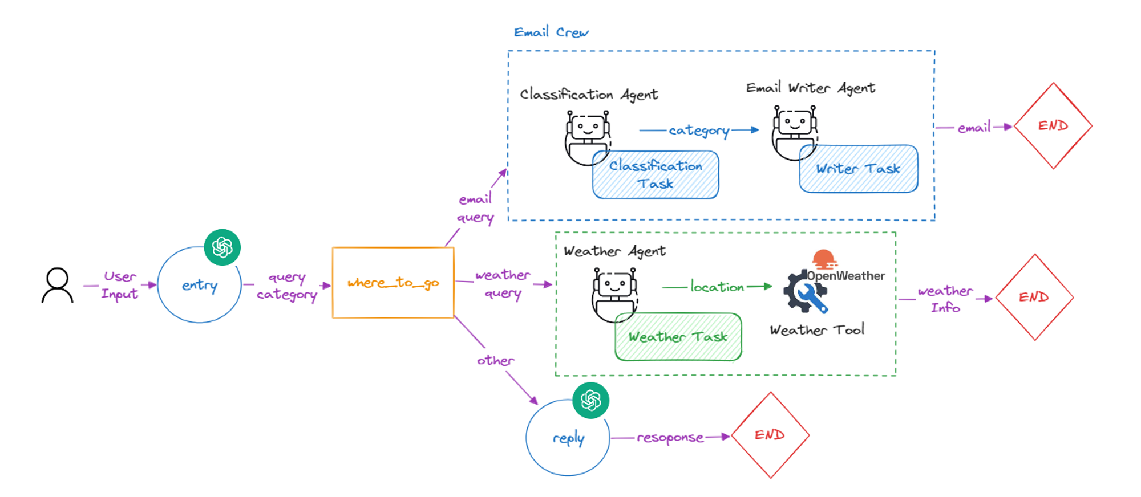
Why LangGraph?

Slide 8
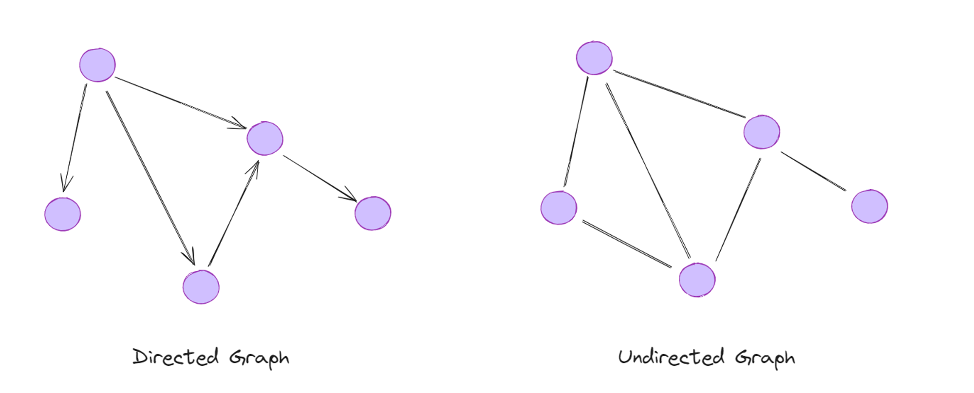
What is LangGraph?
Graph-based orchestration framework
Built for multi-step reasoning
Supports conditional routing
Enables loop control and state persistence

Slide 9
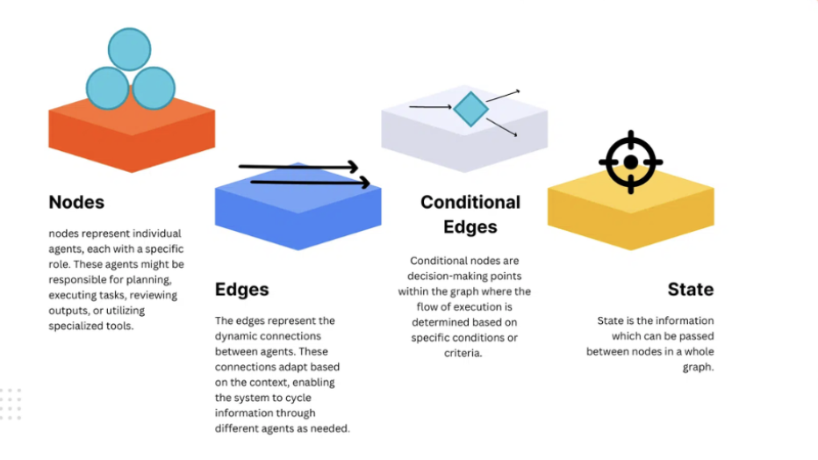
Core Concepts Overview

Slide 10
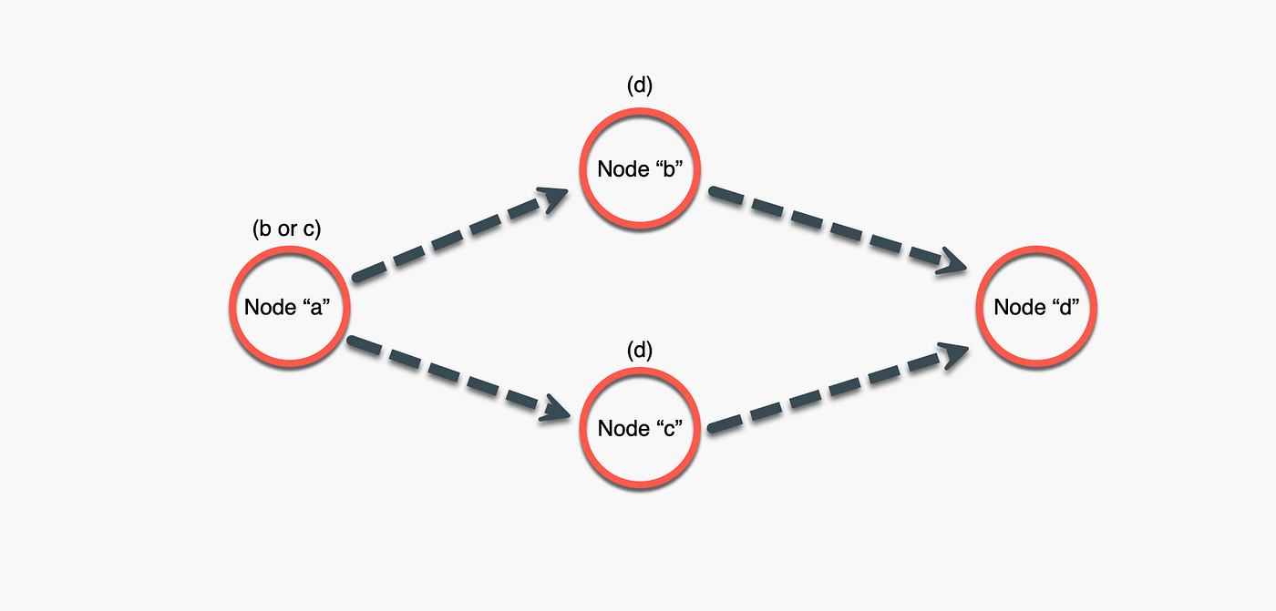
State Management
Structured object passed across nodes
Maintains memory across steps
Improves reproducibility
Enables observability

Slide 11
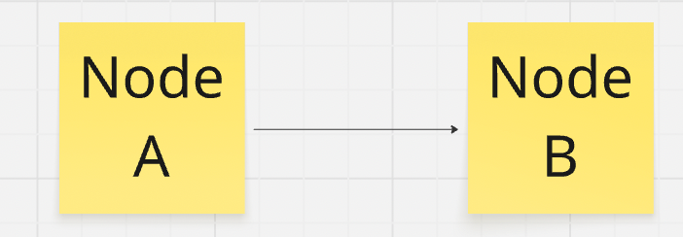
Nodes
Represent computation units
LLM calls
Tool calls
Custom logic functions
Retrieval components

Slide 12
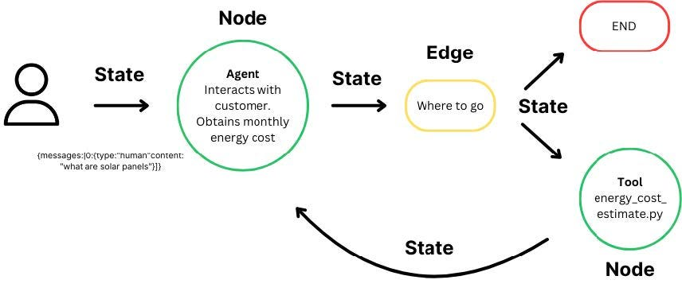
Edges
Define execution flow
Static edges
Conditional edges
Enable dynamic transitions

Slide 13
Execution Flow
Start at entry point
Node updates state
Edge determines next step
Continue until termination condition

Slide 14
Graph vs Chain
Chains are linear
Graphs allow branching
Graphs allow loops
Graphs enable complex workflows

Slide 15
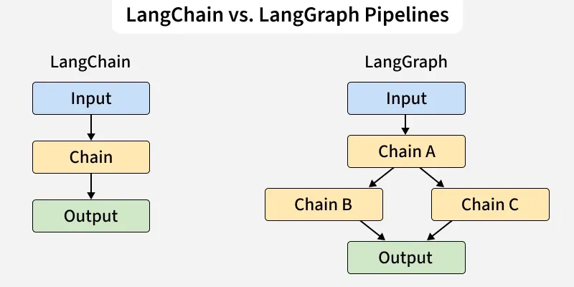

Slide 16
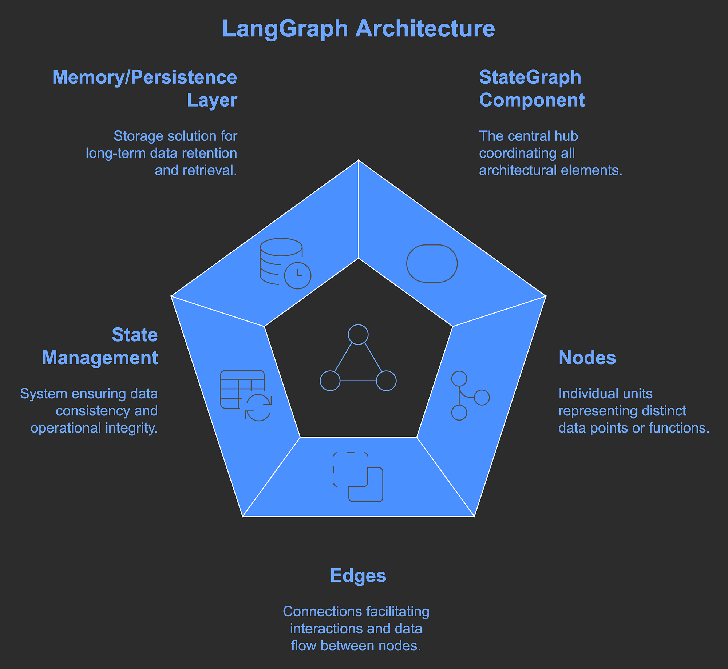

Slide 17
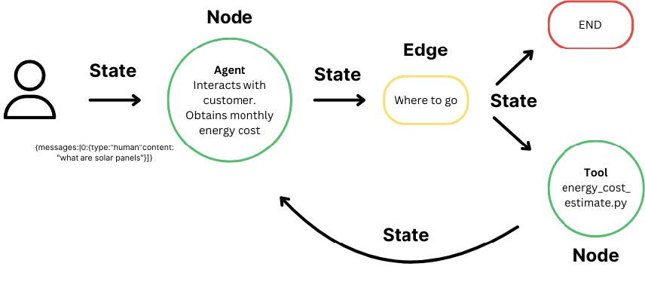
High-Level Architecture

Slide 18
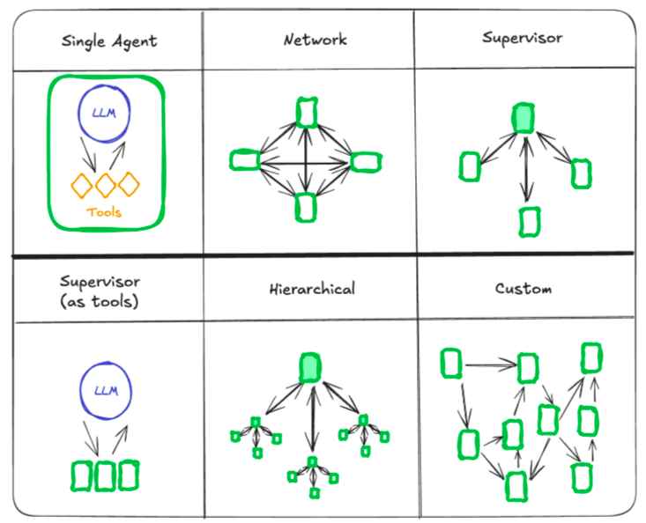

Slide 19
Deterministic + Agent Hybrid Model
Fixed workflow sections
Agent-driven decision nodes
Controlled loop limits
Safe production deployment

Slide 20
Sequential Pattern
Node A → Node B → Node C
Best for fixed pipelines
Used in data transformations

Slide 21
Conditional Routing Pattern
Router Node decides next step
Used in multi-intent handling
Tool selection workflows

Slide 22
Loop Pattern
Iterative refinement
Tool retries
Self-correction workflows

Slide 23
Multi-Agent Pattern
Planner → Executor → Critic
Self-evaluation systems
Guardrail enforcement

Slide 24
Enterprise RAG Flow
User Query
Classifier
Retriever
Re-ranker
LLM Generator
Judge
Final Response

Slide 25
Tool Orchestration Example
Financial assistant workflow
Pricing API call
Compliance validation
Summary generation

Slide 26
Observability Benefits
Inspect state per node
Trace transitions
Log intermediate outputs
Production debugging support

Slide 27
Error Handling
Fallback nodes
Retry loops
Timeout handling
Safe termination

Slide 28
Scalability
Parallel branches
Independent node scaling
Modular architecture

Slide 29
When to Use LangGraph
Complex multi-step workflows
Tool orchestration
Enterprise-grade systems
Systems requiring auditability

Slide 30
When Not to Use LangGraph
Simple chatbot applications
Single-step prompt systems
Static workflows without branching

Slide 31
FDE Role in LLM Deployments
Client architecture design
Production debugging
Workflow customization
Enterprise compliance handling

Slide 32
Why LangGraph is Valuable for FDEs
Clear workflow diagrams
Controlled orchestration
Reusable graph modules
Easier client communication

Slide 33
Debugging Advantages
Reproducible execution paths
State inspection
Node-level visibility

Slide 34
Governance & Compliance
Mandatory validation nodes
Structured execution flow
Audit-friendly architecture

Slide 35
Performance Optimization Points
Retrieval optimization
Re-ranking tuning
LLM selection per node
Parallel execution strategies

Slide 36
Integration with RAG Systems
Chunking and embedding nodes
Vector retrieval node
Re-ranking node
Generation node

Slide 37
Integration with Tool Calling
Tool decision node
Tool execution node
Validation node
Response synthesis node

Slide 38
Production Deployment Architecture
Frontend
Backend API
LangGraph Orchestrator
Model APIs
Database + Vector Store

Slide 39
Future of LLM Orchestration
Structured agents
Controlled autonomy
Stateful reasoning
Enterprise-scale AI systems

Slide 40
Key Takeaways
Graph-based orchestration
Stateful workflows
Production-grade reliability
Critical for complex AI systems

Slide 41
Closing Slide
LangGraph enables scalable, controlled,
stateful LLM systems suitable for
enterprise production environments.

